Slide 1
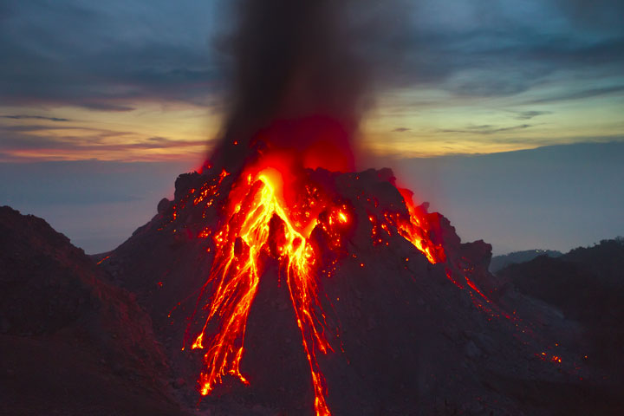
Daily Review
Igneous rocks are formed when magma and lava from volcanic eruptions cools and solidifies.
Think, pair, share: Explain the difference between magma and lava

Slide 2
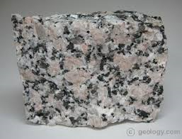
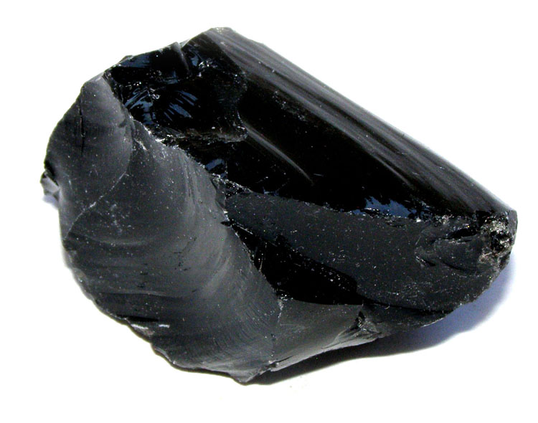
Daily Review
Intrusive igneous rocks are formed when magma cools slowly underground forming large crystals.
Extrusive igneous rocks are formed when lava cools quickly above ground forming small or no crystals.
Which rock is intrusive and which is extrusive? Explain your choice
Obsidian
Granite

Slide 3
Daily Review
An aim is what you are trying to achieve in an experiment.
A hypothesis is a testable statement.
For example:
Aim: To find out if the mass of a paper plane affects the distance it flies
Hypothesis: Planes with a smaller mass fly further than planes with a larger mass

Slide 4
Daily Review
An aim is what you are trying to achieve in an experiment.
A hypothesis is a testable statement.
Aim: To find out if the amount of heat affects how fast chocolate melts
Write a hypothesis for this experiment.

Slide 5
Daily Review
Variables are factors that can affect an experiment.
Independent variable is the one that is deliberately changed
Dependent variable is the one that is tested or measured
Controlled variables are kept the same
Aim: To find out if the amount of food given to fish affects their weight
Independent variable: The amount of food
Dependent variable: The weight of the fish
Controlled variables: Type of food, type of fish, size of the tank

Slide 6
Daily Review
Variables are factors that can affect an experiment.
Independent variable is the one that is deliberately changed
Dependent variable is the one that is tested or measured
Controlled variables are kept the same
Aim: To find out if the type of food affects how quickly mould grows
Independent variable:
Dependent variable:
Controlled variables:

Slide 7
Daily Review
Variables are factors that can affect an experiment.
Independent variable is the one that is deliberately changed
Dependent variable is the one that is tested or measured
Controlled variables are kept the same
Aim: To find out if temperature affects how quickly water evaporates
Independent variable:
Dependent variable:
Controlled variables:

